Slide 1
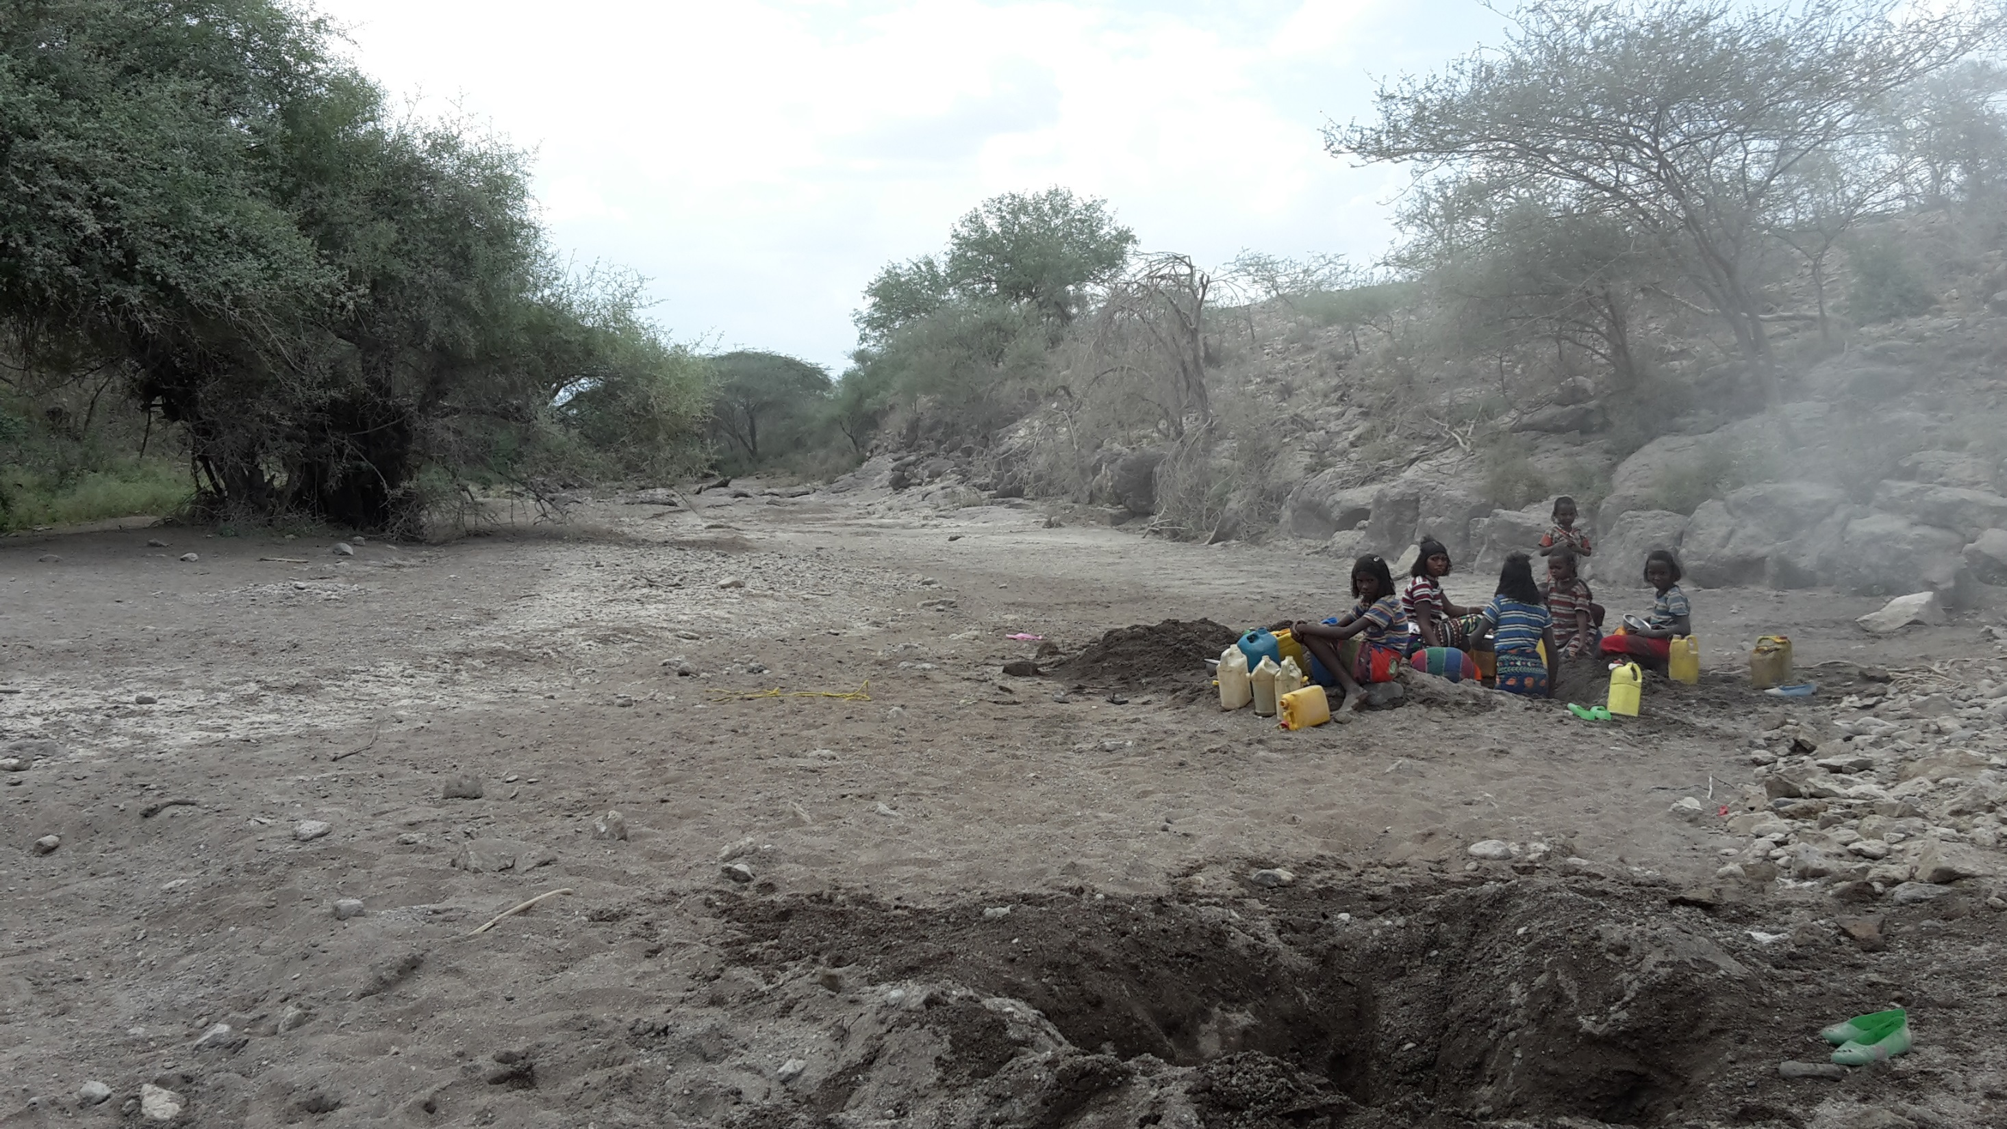
Emotional well-being and water security among pastoralists in Afar, Ethiopia
Notes:
Today I am going to talk about some research I did a couple of years ago looking at the linkages between water security and emotional well-being.
So the research was undertaken among pastoralists in the Afar Region, Ethiopia.
I’m sure you are all aware Pastoralists are traditionally nomadic communities that wander over large expanses of land with their livestock, moving with the rainfall searching for pasture and water.
So in effect, their natural resources are governed by this mobility and also traditional customs which are shared among different clans.
Afar Pastoralists live in very pressured environment regarding water, with heavy reliance on unimproved water sources.
Extremely water-stressed area, climate change and depleting water sources.
Other pressures include hostile government policies such to resettle and the re-appropriation of land for agriculture

Slide 2
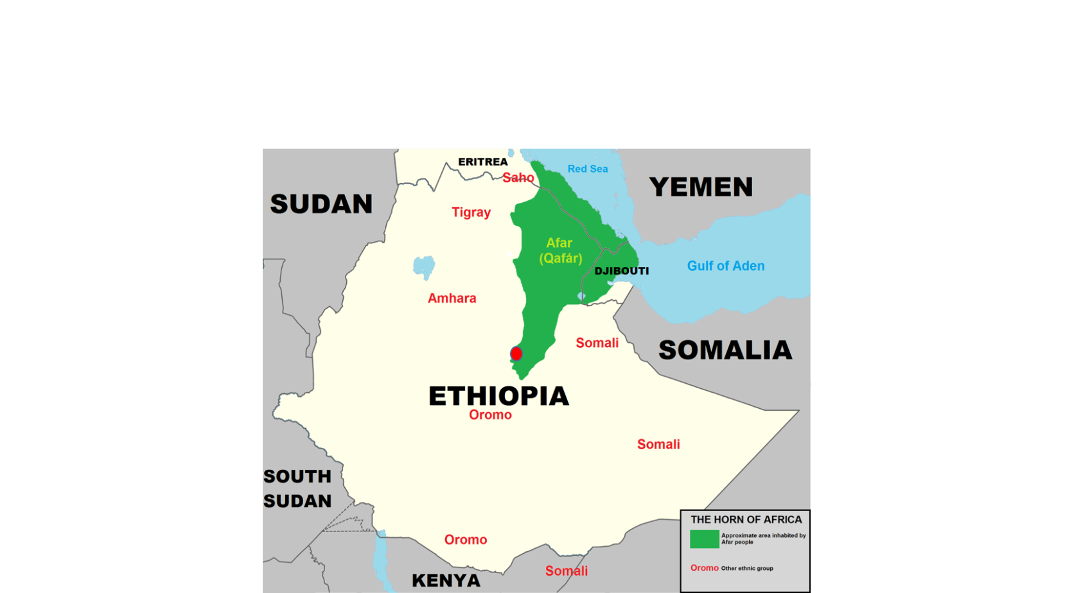
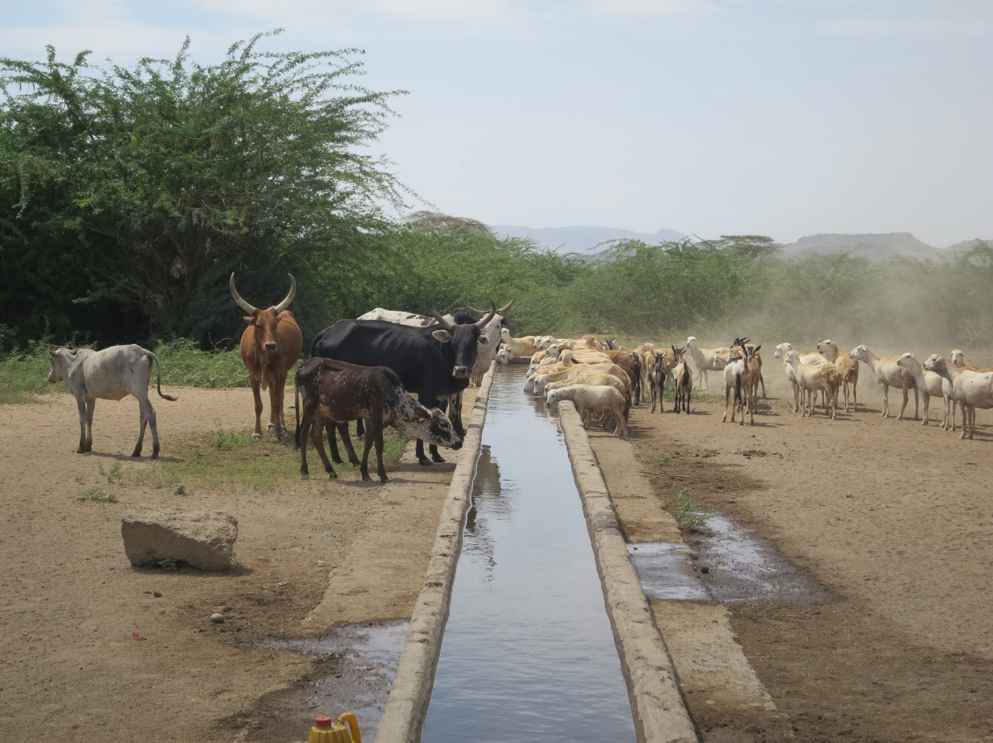

Slide 3
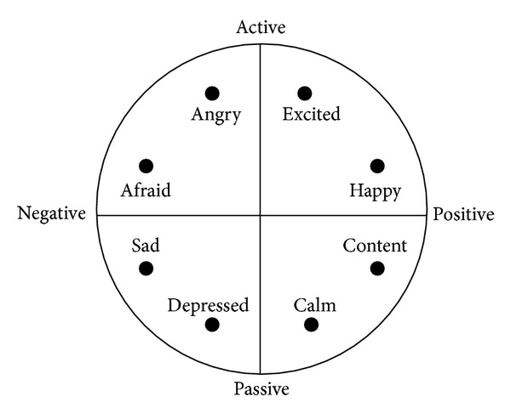
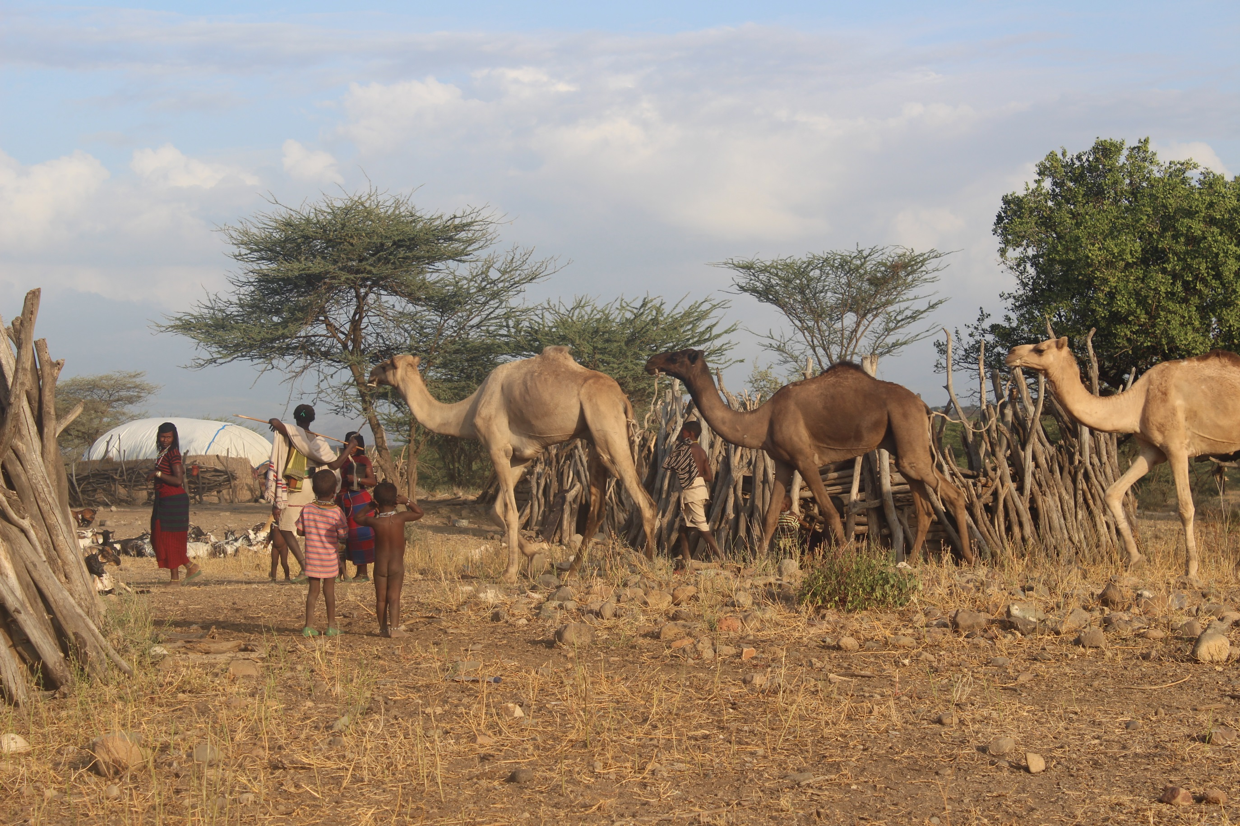

Slide 4
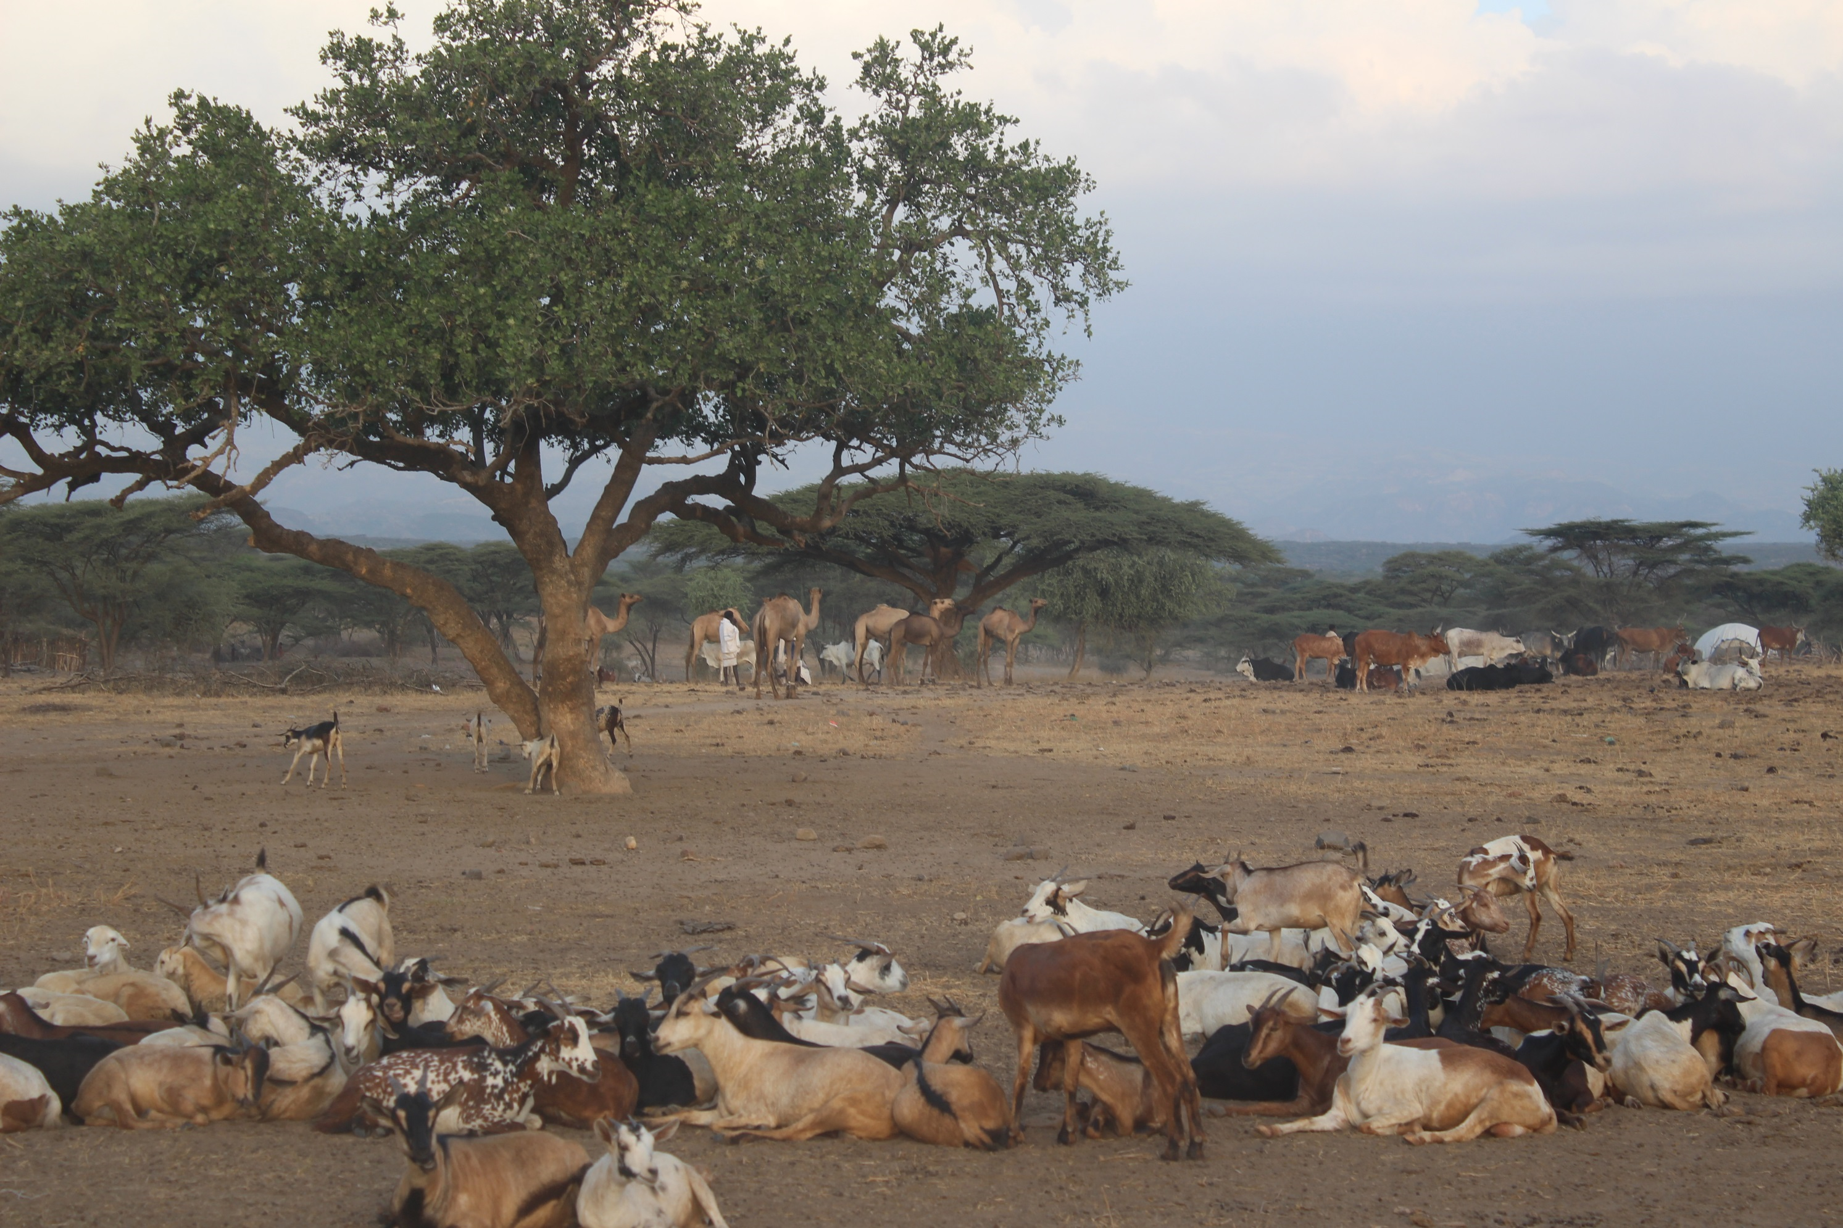
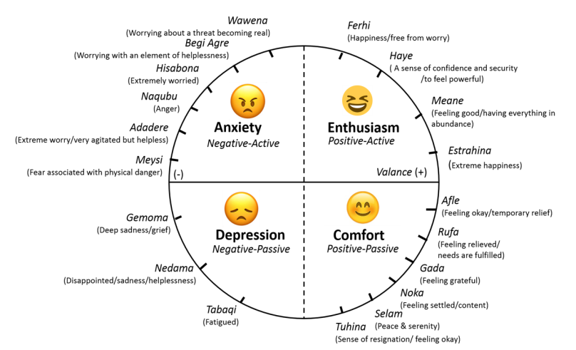

Slide 5
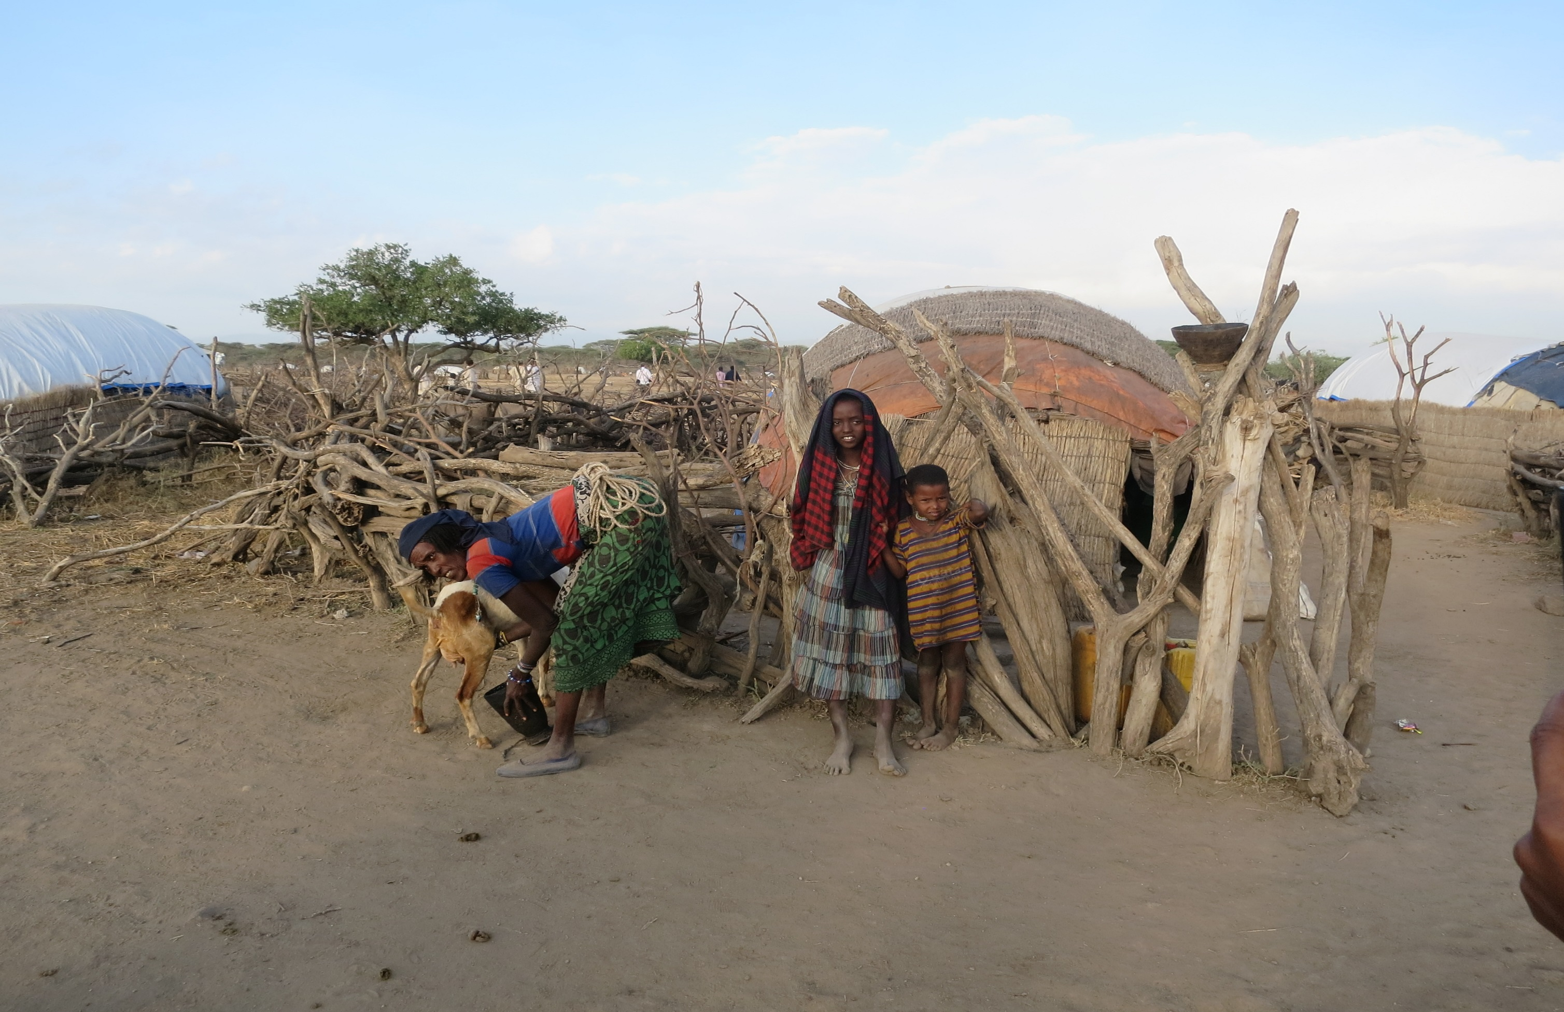

Slide 6
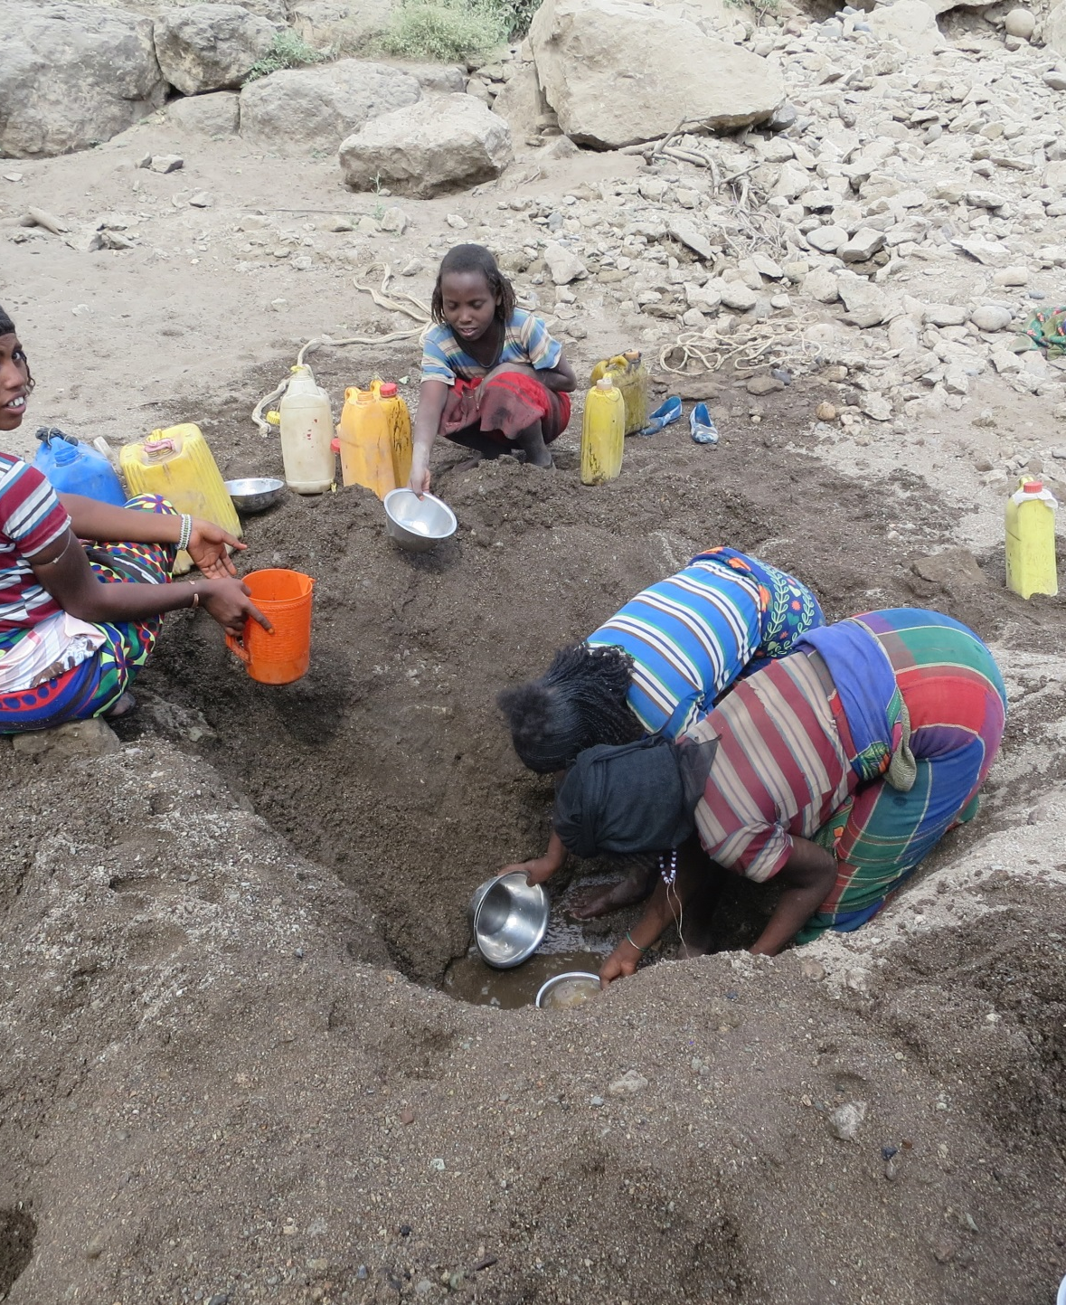
Thank you for listening!

